Slide 1
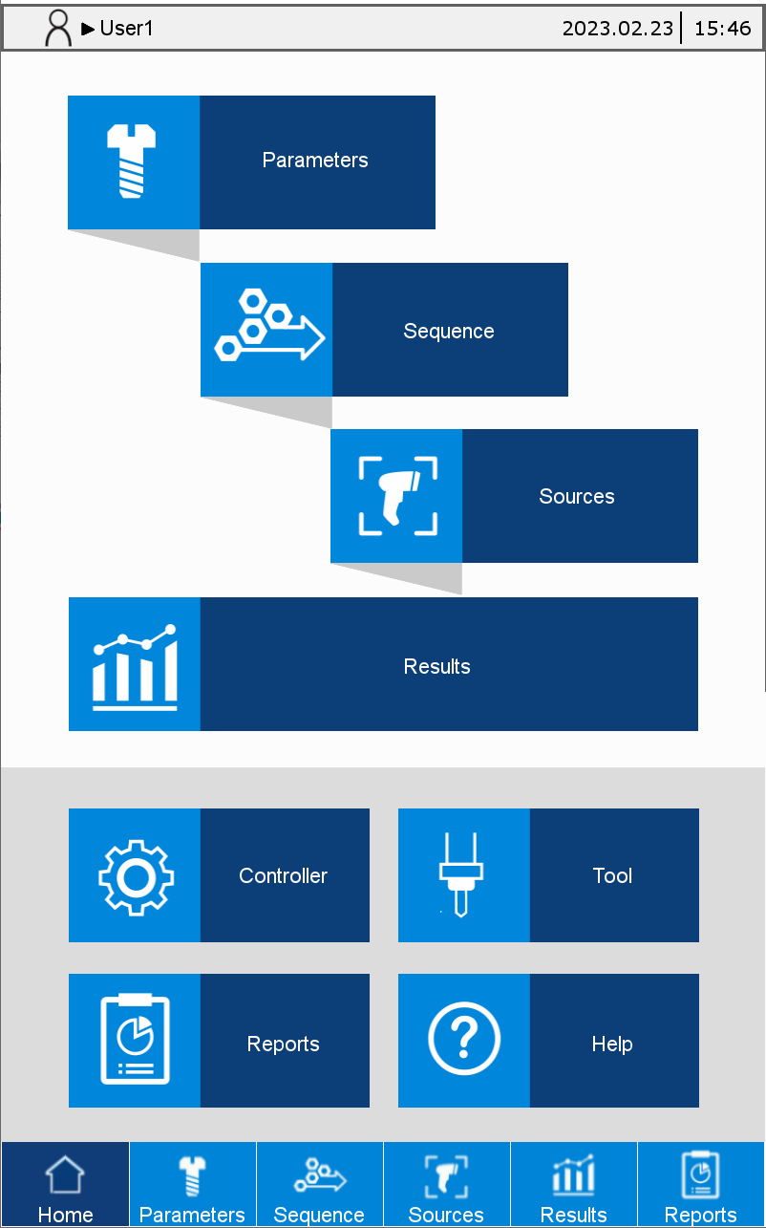
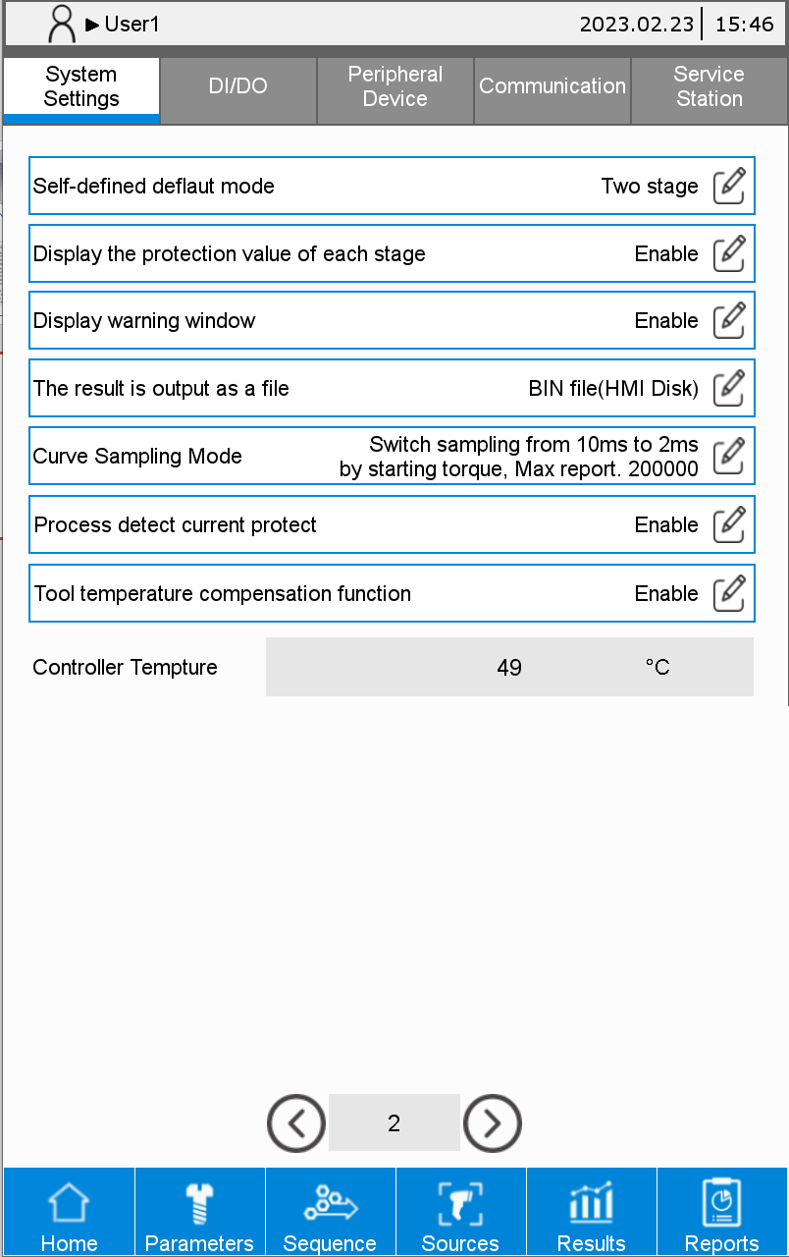
Screw Driver export Result.Bin file

Slide 2


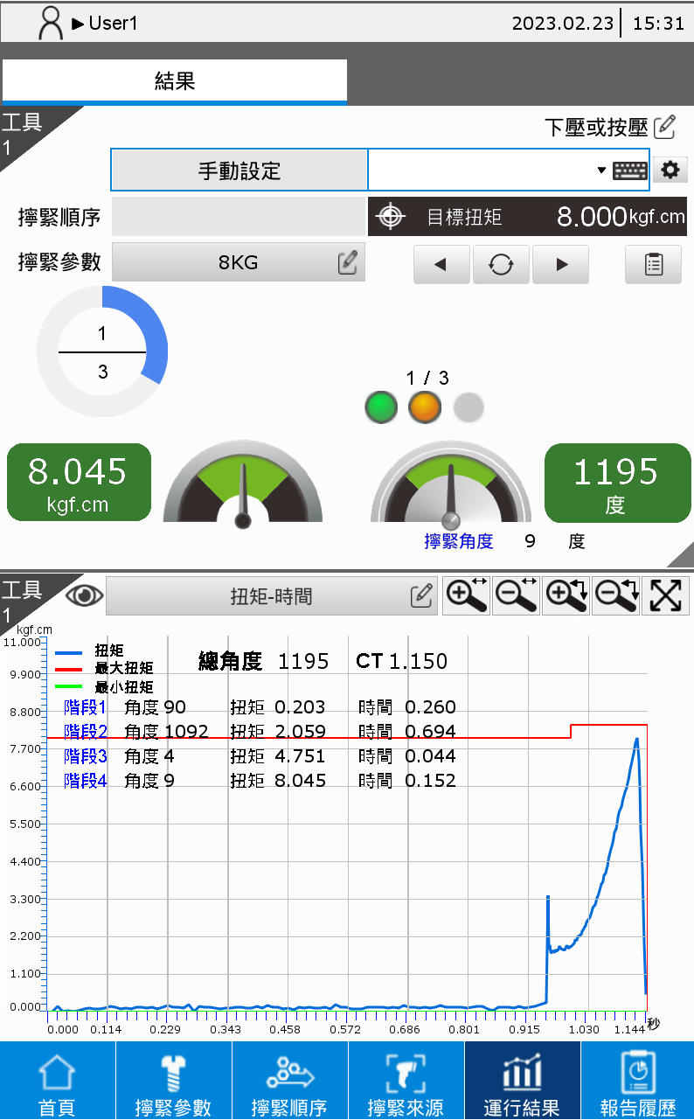

FTP
When each tightening is completed,
the controller export result .bin file to the HMI Disk.
If more than 100 bin file, overwrite the first bin
Results. bin
Follow Modbus Current No. of production report report enteries (0x6B,0x6C)
ftp://192.168.1.11/ScrewInfo/BIN/ “ID” + ((Report ID(H)(0x6C) * 65536 + Report ID(L)(0x6B) – 1) % 100).ToString()

Slide 3
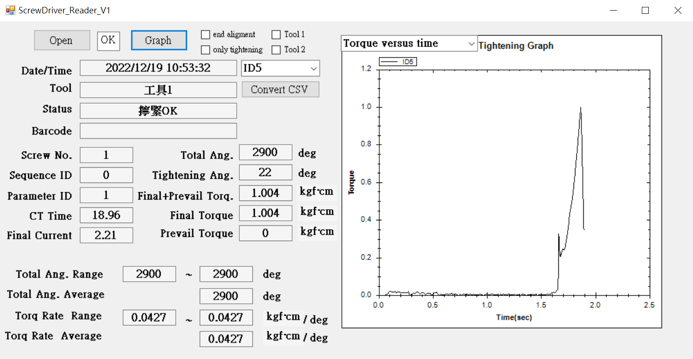
FTP
Offline
CurveReader.exe
Users need to create an ftp client program
And receive the bin file
User can open files with CurveReader.exe
And show the raw data.
User create
FTP
client
ftp://192.168.1.11
Port: 21
User: admin
Password: 1234

Slide 4
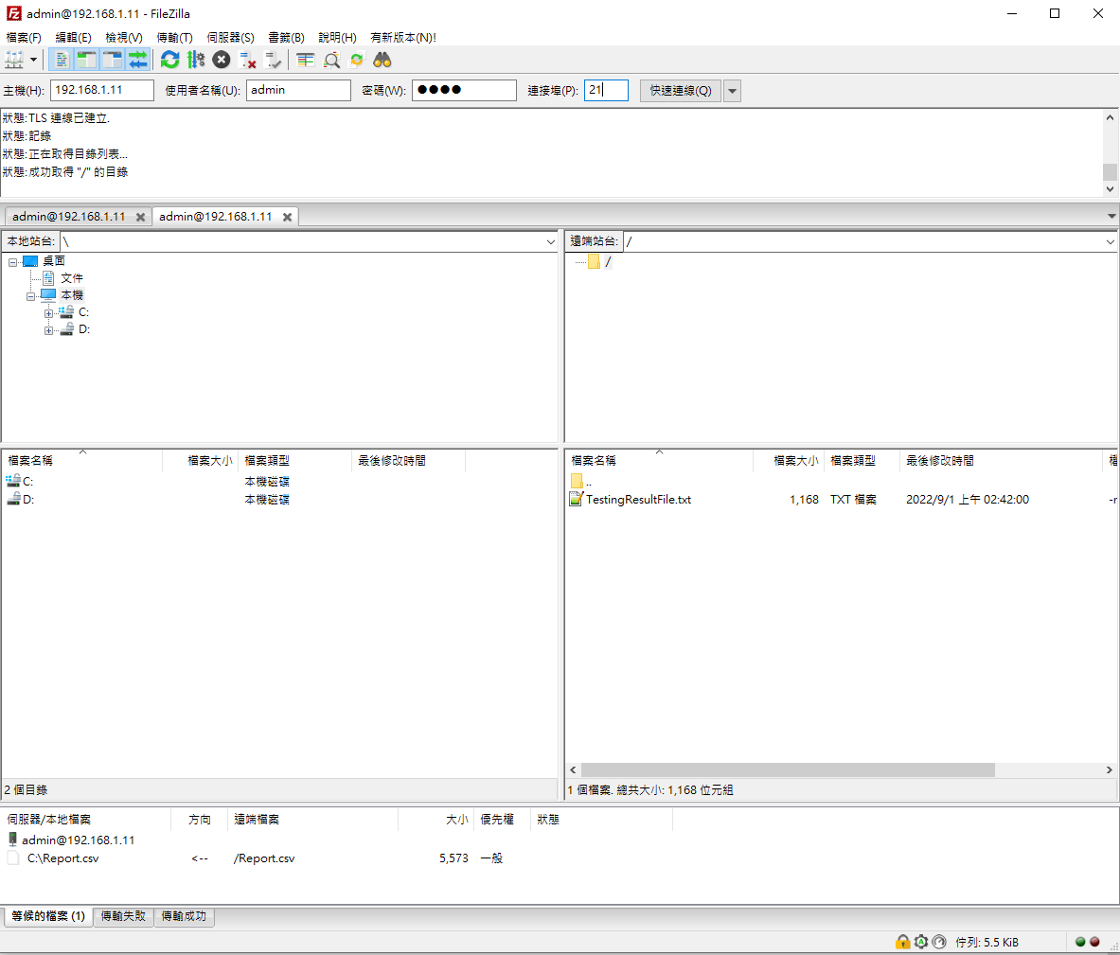
Ex
FTP
FileZilla FTP client
https://filezilla-project.org/
FileZilla Client
Offline
CurveReader.exe
ftp://192.168.1.11
Port: 21
User: admin
Password: 1234

